Slide 1


Pothole Detection Using Convolutional Neural Networks and Transfer Learning
This project aims to develop an efficient system for automatically detecting potholes in road images. By classifying images as 'Normal' or 'Potholes', we can enhance road inspection processes and improve safety.
by Tarun Vaka

Slide 2
Data Collection and Preprocessing
Dataset Sources
Dataset Structure
Preprocessing
Images were sourced from publicly available datasets and web scraping. This includes various road types, lighting, and weather conditions.
The dataset contains two classes: 'Normal' and 'Potholes,' with thousands of images in each category.
Images are resized to a standard resolution (e.g., 224x224 pixels) and normalized to ensure consistent input for the CNN.

Slide 3





Data Preprocessing for Deep Learning
Resizing
Images resized to 128x128 pixels for manageable input size.
Normalization
Pixel values normalized to 0-1 range to improve training stability.
Label Assignment
'Normal' images labeled as 0, 'Pothole' images labeled as 1.
Splitting Dataset
Data split into 80% training and 20% validation sets.

Slide 4
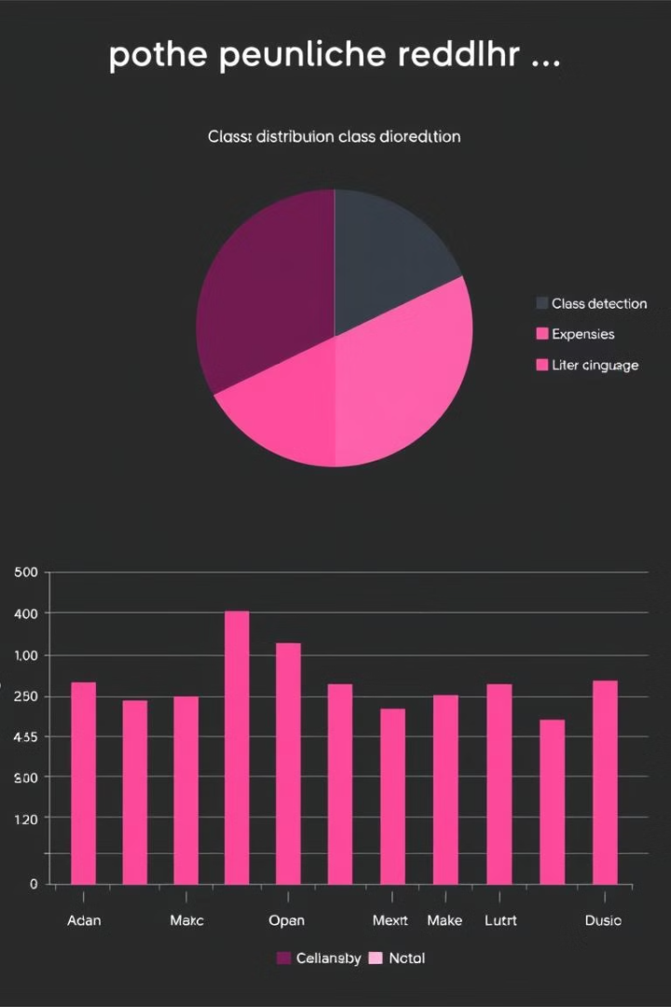
Exploratory Data Analysis (EDA)
1
Class Distribution
2
Handling Imbalance
Visualizations like pie charts and bar graphs used to understand the distribution of 'Normal' and 'Pothole' classes in the dataset.
Techniques like data augmentation or weighted loss functions can address potential class imbalances, ensuring the model doesn't favor one class over the other.

Slide 5

Baseline CNN Model Architecture
1
Convolutional Layers
Extract features from input images using learned filters.
2
Max Pooling Layers
Reduce dimensionality and provide spatial invariance.
3
Flatten Layer
Converts multi-dimensional feature maps into a single vector.
4
Dense Layers
Perform classification based on extracted features.

Slide 6
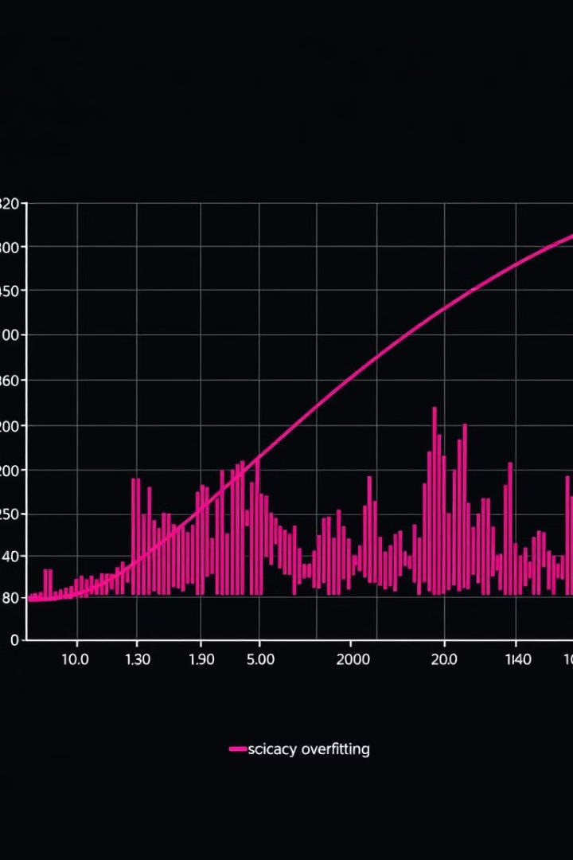
Baseline Model: Training and Evaluation
The baseline model, trained using the Adam optimizer and binary cross-entropy loss, showed promising results. Initial performance insights are analyzed to guide further improvements.

Slide 7

Transfer Learning with Pretrained Models
Leveraging the power of transfer learning, we employed pretrained models like VGG16, ResNet50, and InceptionV3. These models, trained on massive datasets, provide a head start in feature extraction, potentially leading to enhanced accuracy and faster convergence.

Slide 8
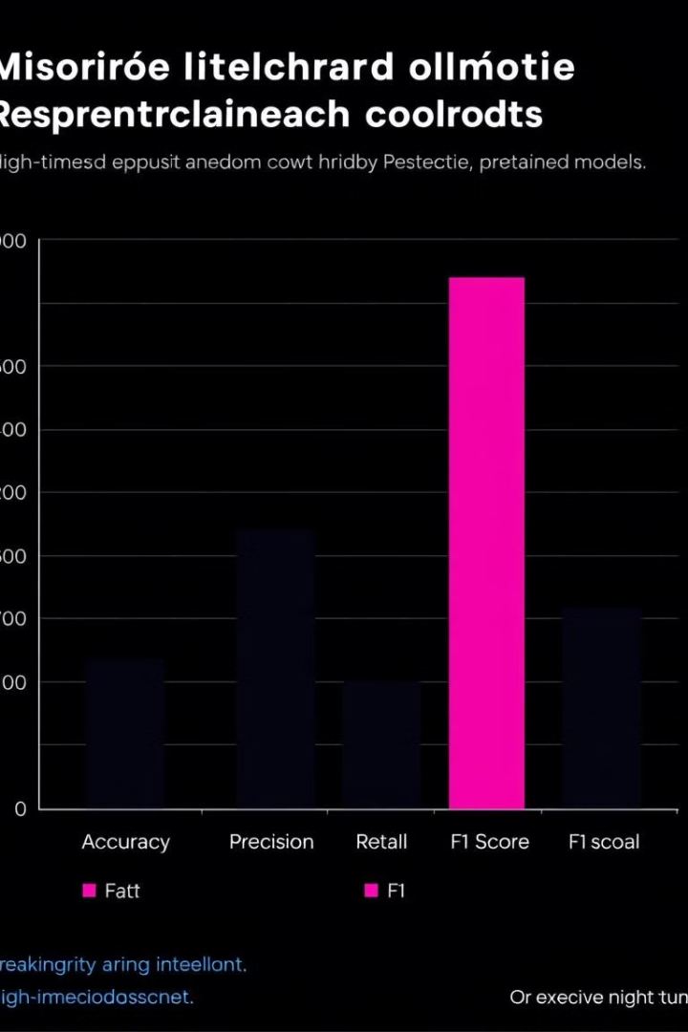
Model Comparison and Evaluation
Model
Accuracy
Precision
Recall
F1-Score
VGG16
88.5%
0.87
0.91
0.89
ResNet50
91.2%
0.92
0.90
0.91
InceptionV3
89.7%
0.88
0.92
0.90

Slide 9

Findings and Future Directions
The project successfully demonstrated the effectiveness of CNNs and transfer learning for pothole detection. The best-performing model can be integrated into road inspection systems, improving safety and efficiency. Future work includes exploring real-time detection and addressing limitations like varying lighting conditions and image quality.

Slide 10

Q&A
Let's discuss. Your questions and insights are highly valued!

